Slide 1
PHYSICAL DIAGNOSTIC
Diagnostic overview.
Diagnostic message strategy.
Diagnostic message Identification.
Diagnostic message addressing.
Protocol Control Information (PCI) formats for GMLAN.
Service Identifier overview.
Oct-22-2019
Dan Nguyen

Slide 2
Diagnostic overview
Send CAN message with Diagnostic service request
User/ECU
ECU
Send CAN message with Diagnostic service response
Example:
Request read DID 01: 24D 02 1A 01
Response:
64D 10 08 5A 01 XX XX XX XX
24D 30 00 00 (Request read more)
64D 21 XX XX
CAN Identifiers (CANID)
Protocol Control Information (PCI)
Service Identifier (SID)
Data By Identifier (DID)
XX
Data of DID

Slide 3
Diagnostic message strategy
UUDT
Single frame response
Diagnostic message
strategy
Single frame response
USDT
Multi-frame response
USDT: Unacknowledged Segmented Data Transfer
UUDT: Unacknowledged Unsegmented Data Transfer
Example USDT:
Request read DID 01: 24D 02 1A 01
Response:
64D 10 08 5A 01 XX XX XX XX
24D 30 00 00
64D 21 XX XX
Example UUDT:
Request read PID: 24D 05 AA 01 22 A1 10
Response:
54D 22 AD 12
54D 10 12 7B 48 32 90
54D A1 98 34 45
Multi-frame response
UUDT frame response
UUDT frame response
UUDT frame response

Slide 4
Diagnostic message Identification
Physical Request CAN Identifier (USDT)
AllNode Functional Request CAN Identifier (USDT)
Diagnostic CAN Identifiers (CANId’s)
Physical USDT Response CAN Identifier
Physical UUDT Response CAN Identifier
OBD/EOBD CAN Identifiers
Notes:
Physical Request CAN Identifier (USDT):
This CAN Identifier shall be used to transmit physically addressed single frame or multiple frame request messages to a single ECU utilizing the Network USDT protocol with normal addressing. This CAN Identifier shall also be used by the tester to send FlowControl frames to an ECU if the transmission of data from an ECU to the tester requires a multiple frame transmission.
AllNode Functional Request CAN Identifier (USDT)
This CAN Identifier shall be used to transmit functionally addressed single frame request messages to a functional system which consists of one or multiple ECUs utilizing the Network USDT Protocol, with extended addressing (EA). All nodes on the subnet where the request was sent shall receive this CANId and evaluate the extended address in order to determine if the request is valid for that specific ECU. The extended address represents a functional system address (see the section on Functional System Assignments for more information).
Physical USDT Response CAN Identifier:
This CAN Identifier shall be used to transmit physically addressed single frame or multiple frame response messages to the tester utilizing the Network USDT protocol with normal addressing. This CAN Identifier shall also be used by the ECU to send FlowControl frames to the tester if the transmission of data from the tester requires a multiple frame transmission.
Physical UUDT Response CAN Identifier:
This CAN Identifier shall be used to transmit physically addressed single frame UUDT response messages to the tester.
OBD/EOBD CAN Identifiers
These CAN Identifiers shall be supported only by emission related devices. A specific range of Identifiers are reserved for OBD/EOBD purposes and unused identifiers in this range shall not be used for other purposes. The range of reserved OBD/EOBD identifiers is shown in Table 6.4—1: Diagnostic CAN Identifier Assignments. Only nodes on the subnet where the request was sent shall receive this message. This is because the diagnostic strategy does not allow gateways to pass diagnostic messages on to other subnets.

Slide 5
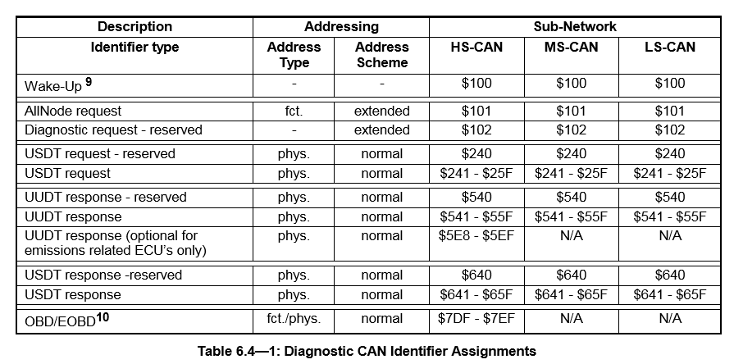
Diagnostic message Identification
Example:
Request read DID 01: 24D 02 1A 01
Response:
64D 10 08 5A 01 XX XX XX XX
24D 30 00 00 (Request read more)
64D 21 XX XX
Legend: fct.: functional;
phys.: physical;
N/A: not applicable

Slide 6
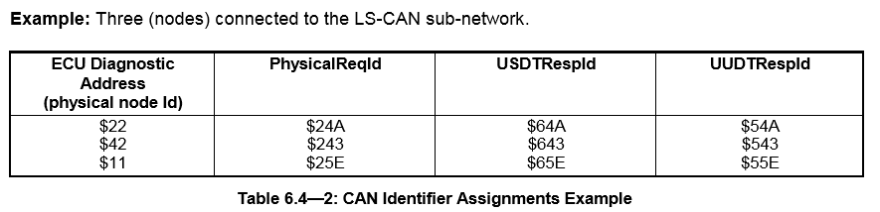
Diagnostic message Identification
• $2xx = physical request CAN Identifier
• $5xx = UUDT response CAN Identifier
• $6xx = USDT response CAN Identifier
Example USDT:
Request read DID 01: 24D 02 1A 01
Response:
64D 10 08 5A 01 XX XX XX XX
24D 30 00 00 (Request read more)
64D 21 XX XX
Example UUDT:
Request read PID: 24D 05 AA 01 22 A1 10
Response:
54D 22 AD 12
54D 10 12 7B 48 32 90
54D A1 98 34 45
Notes:
The CAN Identifiers of a node shall be chosen in a way that the lower byte of each node CAN Identifier (physical request, USDT response, UUDT response) can be interpreted as a unique offset relative to the diagnostic CAN Identifier range (for a given subnet).

Slide 7
Diagnostic message addressing
Diagnostic message addressing
Physically
Functionally
Targeted to a single node
Addressed to one or multiple nodes
All diagnostic response messages will be physically addressed, using one of the reserved range of physical response CANId’s (defined previously).
Back to overview

Slide 8
Protocol Control Information (PCI) formats for GMLAN
Example:
Request read DID 01: 24D 02 1A 01
Response:
64D 10 08 5A 01 XX XX XX XX
24D 30 00 00 (Request read more (auto) )
64D 21 XX XX
Addressing scheme name | Identifier | CAN frame data field
Description | ID | 1 | 2 | 3 | 4 | 5 | 6 | 7 | 8
NORMAL - SingleFrame | CAN Id | PCI
NORMAL - FirstFrame | CAN Id | PCI
NORMAL - FlowControl | CAN Id | PCI
NORMAL - ConsecutiveFrame | CAN Id | PCI
Location of Protocol Control Information (PCI) using normal addressing

Slide 9
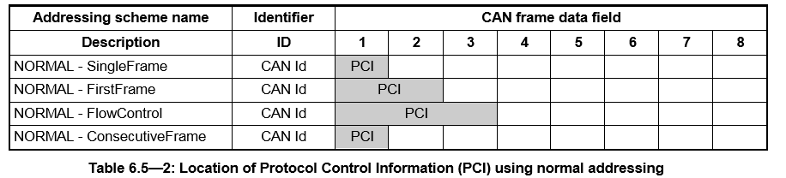
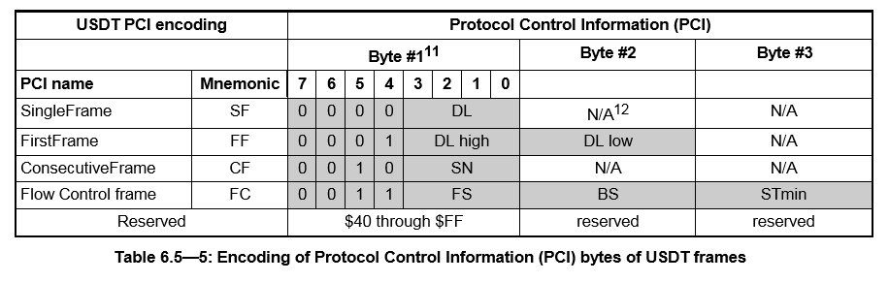
Protocol Control Information (PCI) formats for GMLAN

Slide 10
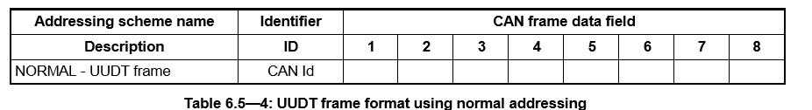
Protocol Control Information (PCI) formats for GMLAN
Single Frame
 | Protocol Control Information (PCI)
 | Byte #1 |  |  |  |  |  |  |  | Byte #2 | Byte #3 | Byte #4 | Byte #5 | Byte #6 | Byte #7 | Byte #8
PCI name | 7 | 6 | 5 | 4 | 3 | 2 | 1 | 0
SingleFrame | 0 | 0 | 0 | 0 | DL
Legend: DL: Data length
Example UUDT:
Request read PID: 24D 05 AA 01 22 A1 10
Response:
54D 22 AD 12
54D 10 12 7B 48 32 90
54D A1 98 34 45
Single frame
UUDT single frame response
UUDT single frame response
UUDT single frame response

Slide 11
Protocol Control Information (PCI) formats for GMLAN
Multiple Frame
 | Protocol Control Information (PCI)
 | Byte #1 |  |  |  |  |  |  |  | Byte #2 | Byte #3 | Byte #4 | Byte #5 | Byte #6 | Byte #7 | Byte #8
PCI name | 7 | 6 | 5 | 4 | 3 | 2 | 1 | 0
FirstFrame | 0 | 0 | 0 | 1 | DL high |  |  |  | DL Low
FlowControlFrame | 0 | 0 | 1 | 0 | FS |  |  |  | BS | STmin
ConsecutiveFrame | 0 | 0 | 1 | 1 | SN
Legend: DL: Data length
FS: Flow Status
BS: Block Size
Stmin: Separation Time minimum
SN: Sequence Number
Example:
Request read DID 01: 24D 02 1A 01
Response:
64D 10 08 5A 01 XX XX XX XX
24D 30 00 00 (Request read more (auto) )
64D 21 XX XX
First Frame
Flow Control Frame
Consecutive Frame
Back to overview
Notes:
FS; The Flow Status (FS) is a 4 bit parameter used to indicate to a sender of a multi-frame message whether it can proceed with the transmission of consecutive frames (CFs).

Slide 12
Service Identifier overview
Each service (test mode) shall be identified by its service Identifier (SID).
Service Identifier (SID) Overview
Service Identifier Hex Value | Service type (bit 6) | Where defined
00 - 0F | Request | reserved by ISO 15031-5/SAE J1979
10 - 1F | Request (bit 6 = 0) | reserved by GM J2190, KWP 2000 Part 2, 3 and GMLAN Enhanced Diagnostic Services
20 - 2F
30 - 3E
3F | Request (bit 6 = 0) | used by GM J2190
40 - 4F | Positive Response | reserved by ISO 15031-5/SAE J1979
50 - 5F | Positive Response to Services ($10 - $3E) (bit 6 = 1) | reserved by GM J2190, KWP 2000 Part 2, 3 and GMLAN Enhanced Diagnostic Services
60 - 6F
70 - 7E
7F | Negative Response | used by GM J2190, KWP 2000, and GMLAN Enhanced Diagnostic Services
80 - BF | Request (bit 6 = 0) | GMLAN Enhanced Diagnostic Services
C0 - FF | Positive Response (bit 6 = 1) | GMLAN Enhanced Diagnostic Services

Slide 13
Service Identifier overview
 |  | Supported in:
Diagnostic Service Name | REQ SID | Diagnostics | Programming | Boot | CANId
(Test Mode) | (hex) |  | (SPS) | Memory | Type
ClearDiagnosticInformation | 04 | M₁ | N/A |  | USDT
InitiateDiagnosticOperation | 10 | C₁ | C₁ |  | USDT
ReadFailureRecordData | 12 | C | N/A |  | USDT
ReadDataByIdentifier | 1A | M | M₂ |  | USDT
ReturnToNormalOperation | 20 | M | M |  | USDT
ReadDataByParameterIdentifier | 22 | U | N/A |  | USDT
ReadMemoryByAddress | 23 | U | N/A |  | USDT
SecurityAccess | 27 | C₂ | M₃ |  | USDT
DisableNormalCommunication | 28 | M | M |  | USDT
DynamicallyDefineMessage | 2C | C | N/A |  | USDT
DefinePIDByAddress | 2D | U | N/A |  | USDT
RequestDownload | 34 | N/A | M |  | USDT
TransferData | 36 | N/A | M |  | USDT
WriteDataByIdentifier | 3B | C | M₄ |  | USDT
TesterPresent | 3E | M | M |  | USDT
ReportProgrammingState | A2 | N/A | M |  | USDT
ProgrammingMode | A5 | M | M |  | USDT
ReadDiagnosticInformation | A9 | M₅ | N/A |  | UUDT
ReadDataByPacketIdentifier | AA | C | N/A |  | UUDT
DeviceControl | AE | C | N/A |  | USDT
Diagnostic Services Overview
In normal case,
• SIDRQ = Service Identifier Request
• SIDPR = Service Identifier Positive response (SIDRQ + $40)

Slide 14
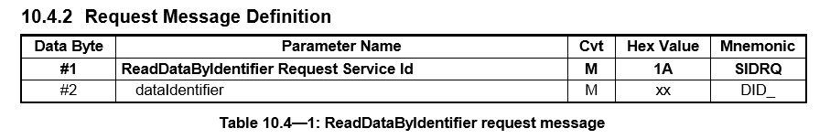
Service Identifier overview
Create request message base on request message table of each service.
Example for ReadDataByIdentifier ($1A) Service
Example:
Request read DID 01: 24D 02 1A 01
Response:
64D 10 08 5A 01 XX XX XX XX
24D 30 00 00 (Request read more (auto) )
64D 21 XX XX
CAN Identifiers (CANID)
Protocol Control Information (PCI)
Service Identifier (SID)
Data By Identifier (DID)
XX
Data of DID

Slide 15
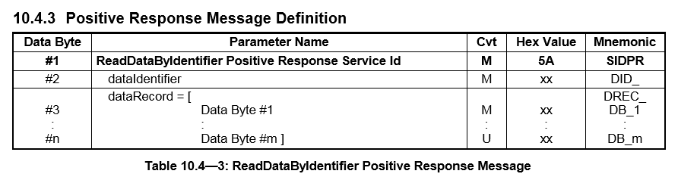
Service Identifier overview
Response message has two types: Positive response and negative response
Example for ReadDataByIdentifier ($1A) Service
Example:
Request read DID 01: 24D 02 1A 01
Response:
64D 10 08 5A 01 XX XX XX XX
24D 30 00 00 (Request read more (auto) )
64D 21 XX XX

Slide 16
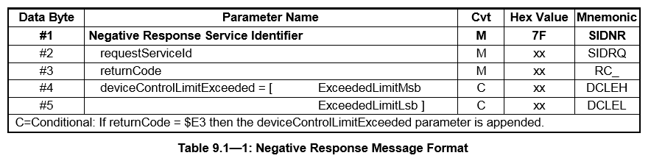
Service Identifier overview
Negative response
Example:
Request read DID 01 with invalid format: 24D 01 1A 01
Response:
64D 03 7F 01 12

Slide 17
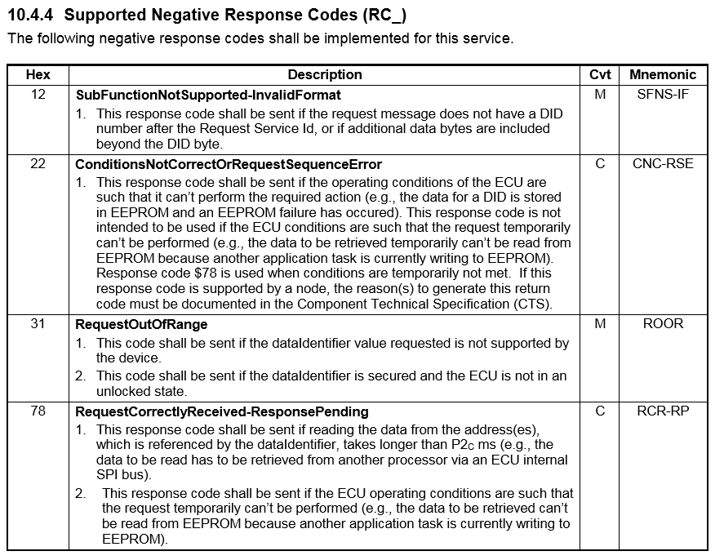
Service Identifier overview
Example for ReadDataByIdentifier ($1A) Service
Back to overview

Slide 18
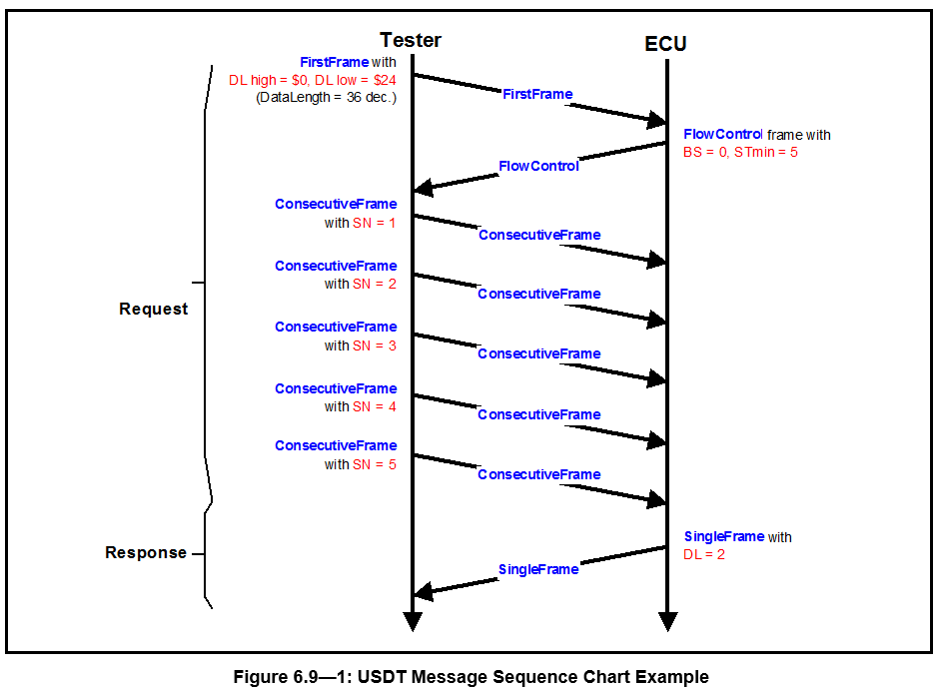
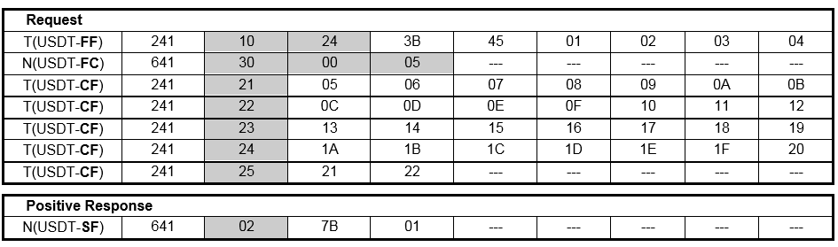
Diagnostic Message Sequence Examples
General USDT Request/Response Sequence Examples

Slide 19
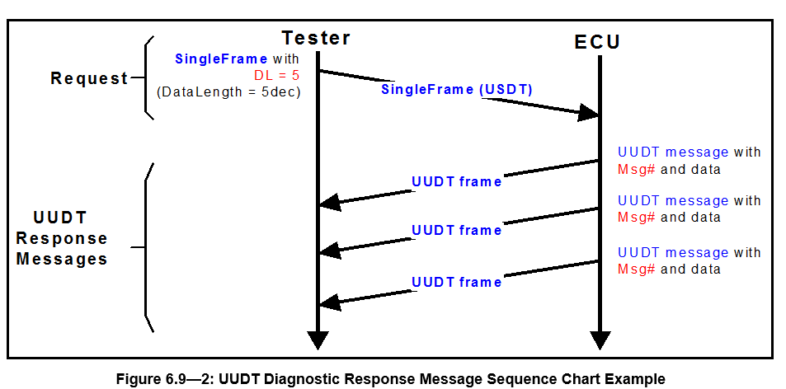
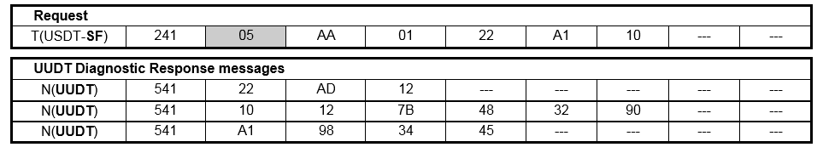
Diagnostic Message Sequence Examples
General UUDT Request/Response Sequence Examples
Back to overview

Slide 20
References
GMW3110_V1.5
GIS-745 Abstract Diagnostic Access Revision 1.1 MY20 (Feb 2nd) – LGE
GEN11 GA TCP ALDL_MY21_v4.x Production-4-17-2019
CG379A

Slide 21


